Slide 1
University of Minnesota
Clinical Legal Education

Slide 2
University of Minnesota
Campus Locations
Twin Cities
East Bank
West Bank
St. Paul
Crookston
Duluth
Morris
Rochester
University Facts
Founded in 1851
Predates the creation of the State of Minnesota
400,000 Alumni
25,000 Employees
Eric Kaler – President
Student Enrollment
69,221 – All Campuses
52,557 – Twin Cities

Slide 3
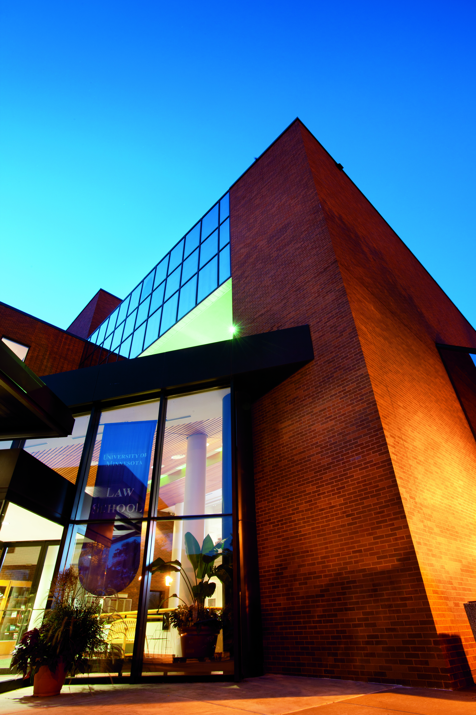
Law School
Founded in 1888
Located on the West Bank
David Wippman – Dean
Top 20 Law School
200 ABA accredited law schools in the US
7th Largest Law Library in the United States

Slide 4
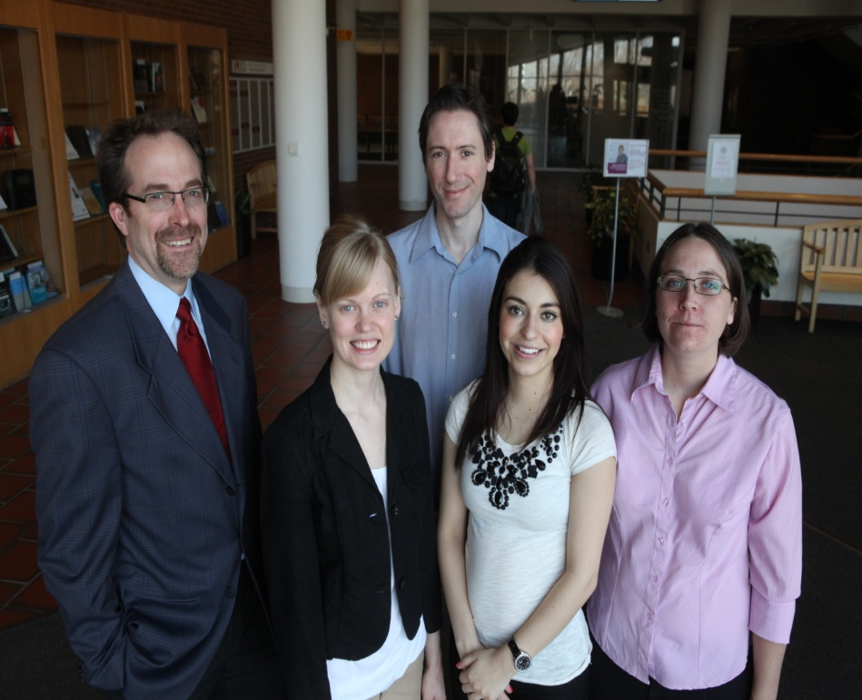
Student Body
852 Students (759 J.D. Students) from 36 states, District of Columbia , Puerto Rico and 7 foreign countries
32% Minnesota Residents
59% Male
41% Female
Fall 2012 – approximately 3200 applicants
205 Students in the 1L class of 2012-2013

Slide 5
Clinical Legal Education
1913 – First U of M clinical program
1968 – Start of current clinical program
Program has steadily expanded over the years
25 Clinical Courses
During the 2012-2013 academic year 229 clinic students handled more than 900 cases
Over 50% of students take at least one live-client clinical course
National average is 25%
U of M students are eligible to take a clinical course as a 2L or 3L
Of 70 full-time faculty – 13 are clinical faculty
18.5% of the full-time faculty teaches in the clinical program

Slide 6
University of Minnesota Law School Clinical Courses
Bankruptcy
Business Law
Child Advocacy & Juvenile Justice
Civil Rights Enforcement
Community Mediation
Community Practice and Policy Development
Consumer Protection
Criminal Justice
Criminal Defense Appeals
Criminal Prosecution Appeals
Environmental Sustainability: Land Use & Water Policy
Federal Defense
Federal Immigration Litigation

Slide 7
University of Minnesota Law School Clinical Courses
Housing Law
Human Rights Litigation & International Legal Advocacy
Immigration & Human Rights Law
Indian Child Welfare Act (ICWA)
Innocence Project
Insurance Law
Misdemeanor Prosecution
Public Interest Law
Civil Practice
Tax
Special Education
Workers’ Rights

Slide 8
Minnesota Rule of Student Practice
A law student enrolled in a clinical course may, under the supervision of a member of the bar, perform all functions that an attorney may perform in representing and appearing on behalf of a client
Minnesota Supreme Court Rule

Slide 9
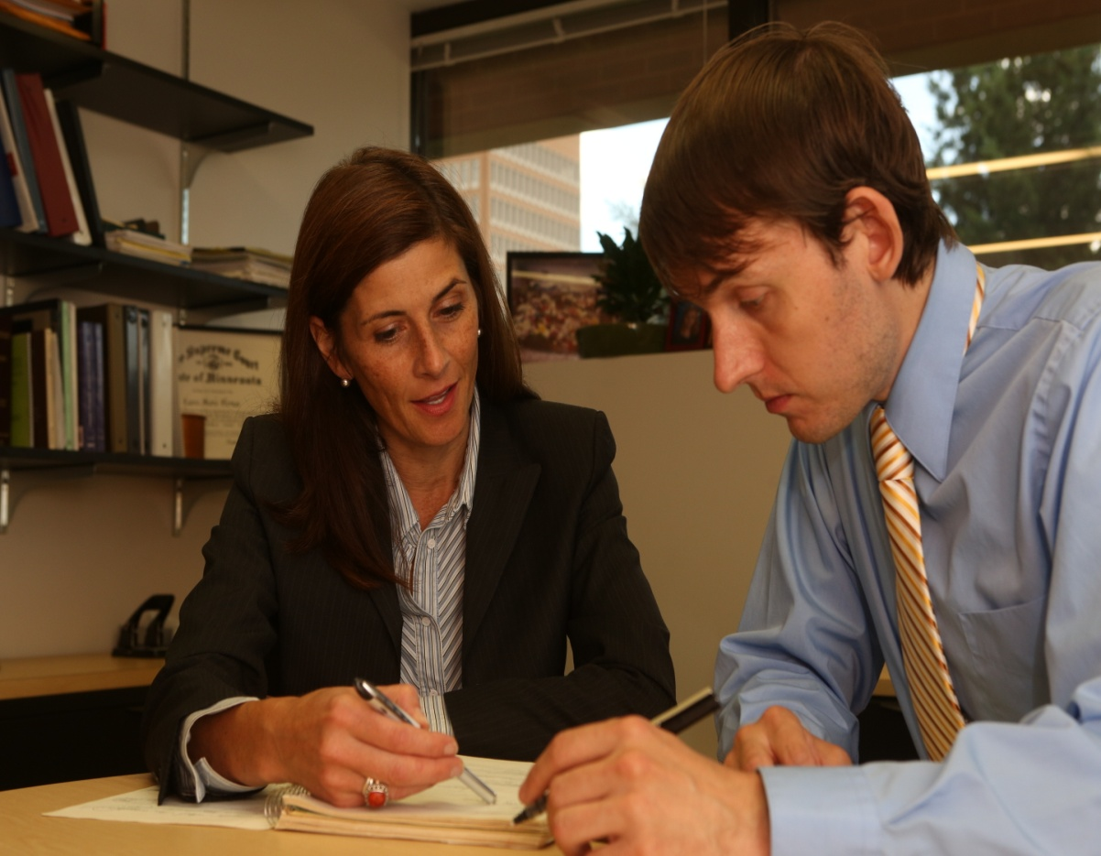
Clinical Program Model
Substantive instruction in the clinical subject area as well as general topics of lawyering skills
Simulations occur in a controlled setting
Students meet with live clients on actual cases under the supervision of a faculty member
Students focus on interviewing, counseling, trial advocacy, appellate advocacy, mediation, negotiation, problem solving, collaboration among professionals, practical research and writing
Client population consists of low income individuals and families referred by a variety of agencies in the Twin Cities

Slide 10
Client Selection
Individuals – usually low income without access to legal representation anywhere else
Entities – organizations involved in social justice projects that retain the clinic for policy work

Slide 11
Case Example
Our Allegation
City of Minneapolis failed to uniformly assess real estate across the city and placed a disproportionate share of the tax burden on low-income properties in a predominately minority resident section of the City
The Law
Tax assessments should be based on market value of property.
Property value to be determined by sales data.

Slide 12


Slide 13
International Human Rights Sample Cases
Kiobel v. Royal Dutch (Corporate Accountability challenged in U.S. Supreme Court)
students worked with coalition of groups supporting plaintiffs' right to sue corporations in U.S. courts
researched and drafted two amicus curiae briefs at two stages of argument at the Supreme Court
students traveled to U.S. Supreme Court to observe the argument and meet with others working on corporate accountability in U.S. courts
Adhikari v. KBR
students working on trafficking case against U.S. contractor on behalf of Nepalese workers and family members of those killed on way from homes in Nepal to U.S. base in Iraq

Slide 14
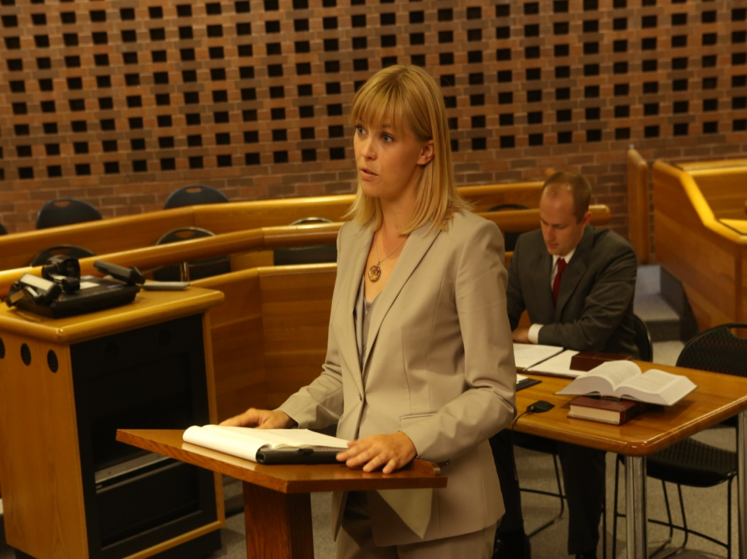
Importance of Clinical Courses
Part of a broader curriculum change
1992 ABA Report (MacCrate Report) faulted law schools for not providing students with enough practical skills

Slide 15
Educational Demands
Potential employers are no longer interested in spending money on training young lawyers
Alumni who donate money want to see graduates ready to “hit the ground running” when they join their law firms
Law students have become increasingly demanding of the educational institution
Clinical legal education has become a large part of the law school response to these demands

Slide 16
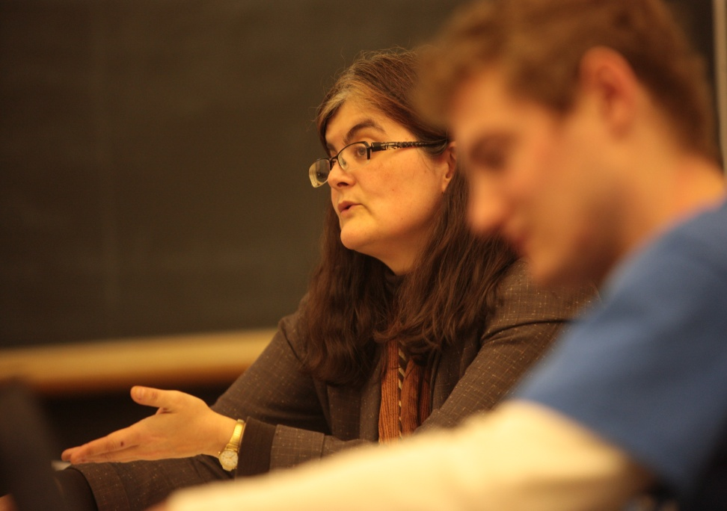
Carnegie Report
2007 Carnegie Report on Educating Lawyers sited three goals
More active, engaging student environment for student participation and personal growth
Greater effectiveness overall in advancing student learning
Increased efficiency in the use of educational resources

Slide 17
Standard Legal Education
Does a remarkable job in teaching thinking (“cognitive apprenticeship” through the signature “case-dialogue method”)
Incorporates practice skills as an add-on without integration
Does little (or has a negative influence) with professional identity and values
Little sense of progression across the three years
Doesn’t do very well in integrating all dimensions of learning
Students end up being very good students or competitive scholars rather than apprentice practitioners
Could be better

Slide 18
Recommended Changes
Offer an integrated curriculum throughout the three years
Combine lawyering, professionalism and legal analysis from the start
Make better use of the second and third year of law school
Support faculty to work across the curriculum
Design the curriculum to weave together disparate kinds of knowledge
Recognize a common purpose – the common, unifying purpose of all law school teachers should be the formation of competent practitioners
Integrate

Slide 19
Changing Curriculum
NYU is a leader in stressing simulations and clinical offerings
New courses for 1Ls across the country
Adding clinics , electives focused on practical skills and courses in interdisciplinary fields
Duke Law School offers 1L course focusing on the practice of law
U of MN in 2009 began requiring 1L students to take a course in Practice and Professionalism
Washington and Lee University replaced their entire 3L curriculum with simulation courses
Harvard and Stanford doubling clinical offerings

Slide 20
Changing Faculty
Movement to integrate clinic and non-clinic faculty
Doctrinal faculty is spending more time teaching simulations and capstone courses
U of MN clinical faculty regularly teach doctrine classes as well as produce scholarship
Coursework geared to teaching what it means to be a lawyer in addition to the law
Spring of 2011 U of MN faculty vote to provide unified track for both clinic and non-clinical faculty One full-time clinical faculty is tenured with two others on tenure-track

Slide 21
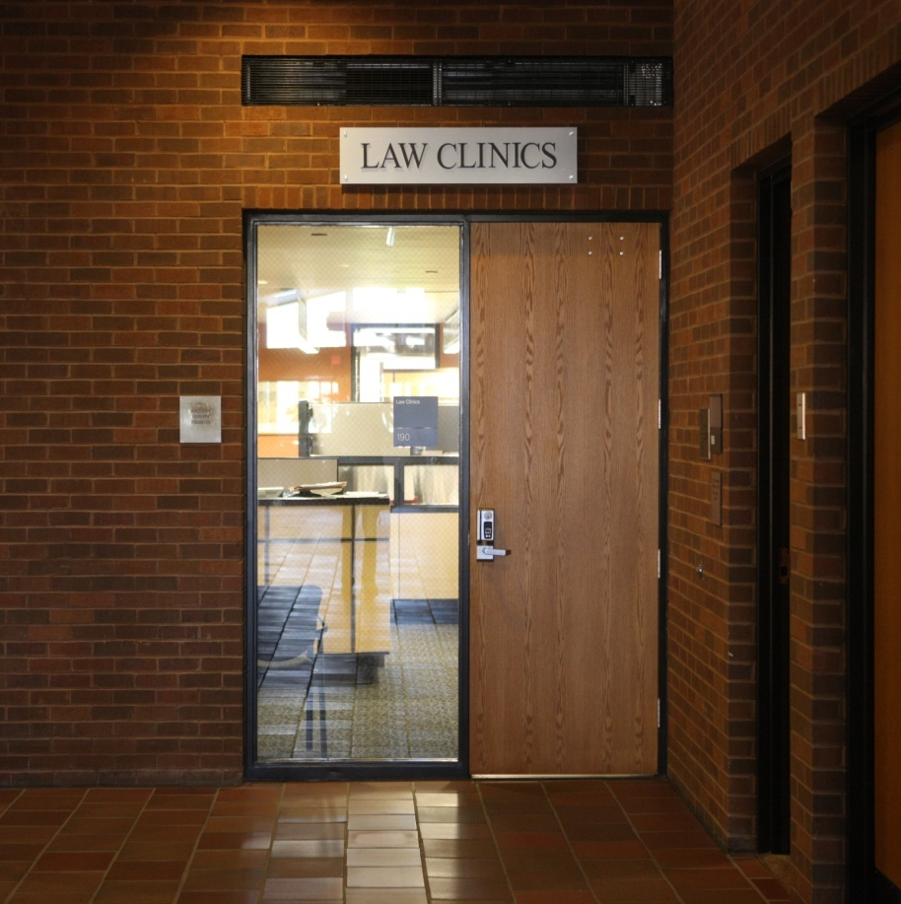
Future of Legal Education
There has been more emphasis on curriculum development in the last several years than in the previous decades…and the importance of clinical legal education is an important part of that new direction

